Slide 1
How to Launch a Lifesaving Platform
Ashley Parks
Sr. DevOps Engineer Toyota Connected North America

Slide 2

Transforming Toyota from an automotive company to a mobility company through connected intelligence services.
Founded in 2016
200 + employees
2.3 Million US vehicles sold in 2021

Slide 3

Delighting drivers and saving lives with cutting edge safety and convenience services

Slide 4
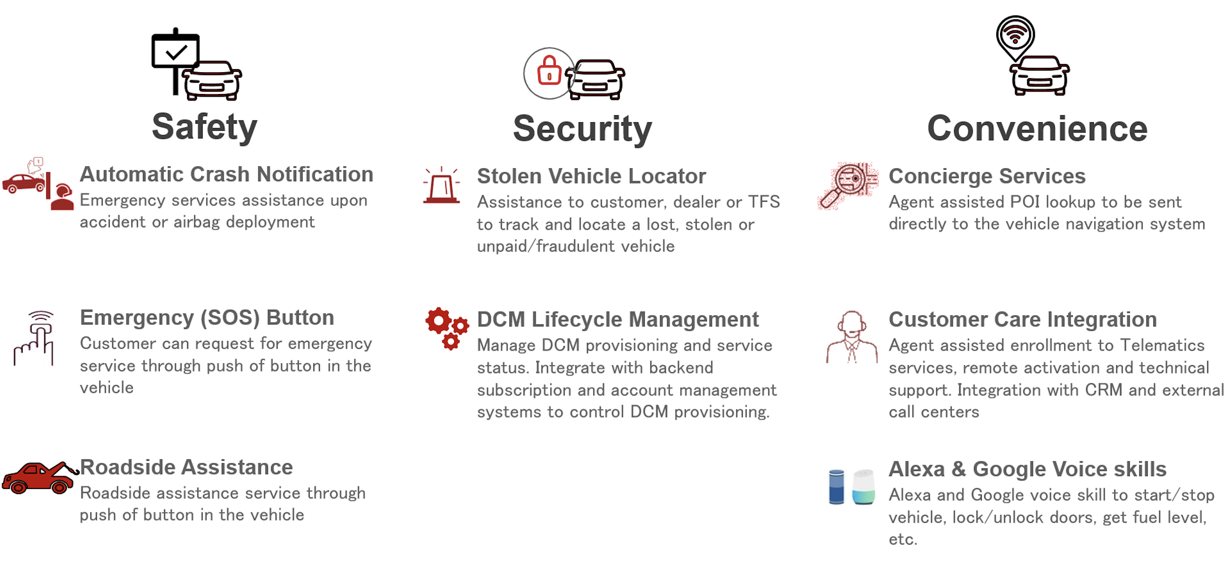

Slide 5

Example Call

Slide 6
Scale Expected (year 1)
1.358M vehicles on the road
54.5k calls per month

Slide 7
SLAs
Emergency Calls & Destination Assist
Infrastructure
90% of transactions < 3 seconds
99.99% Uptime

Slide 8
STEP 1:
AGILE DEVELOPMENT

Slide 9
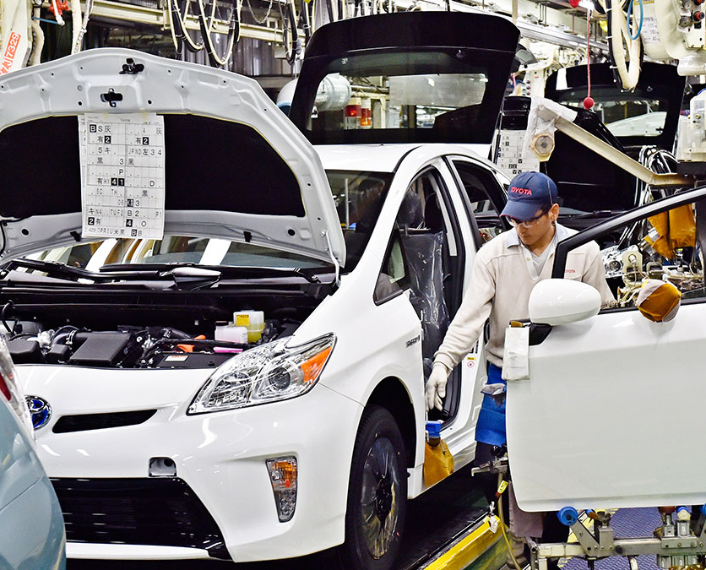
SCRUM @ Toyota
1950 – Toyota Production System
Agile & Kanban
Kaizen

Slide 10











Stack (Pre-Launch)
Code
Infrastructure
Java (Spring Boot)
Go
Maven
ServiceBus (Messaging)
CosmosDB (Database)
Redis (Cache)
GitHub
Azure
AKS (Kubernetes)
Nginx & APIM
ELK (logging)
Datadog (monitoring)

Slide 11
STEP 2:
VISIBILITY

Slide 12
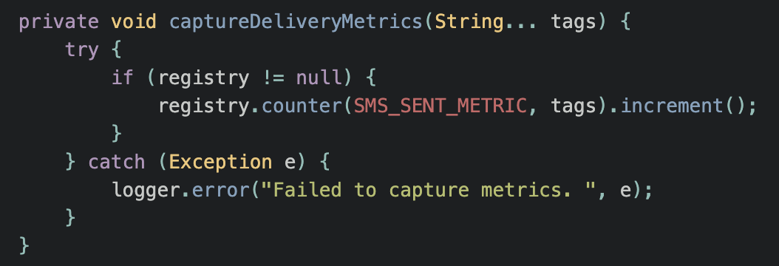
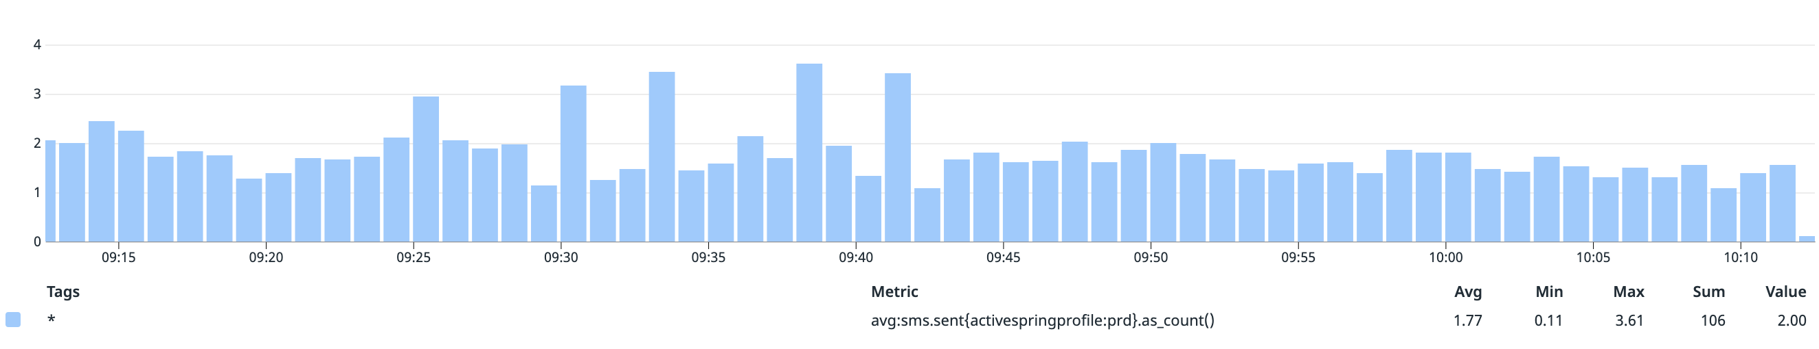
Custom Java Metrics
DogstatsD
Common metric library
Messaging library integration
Servicebus metrics

Slide 13
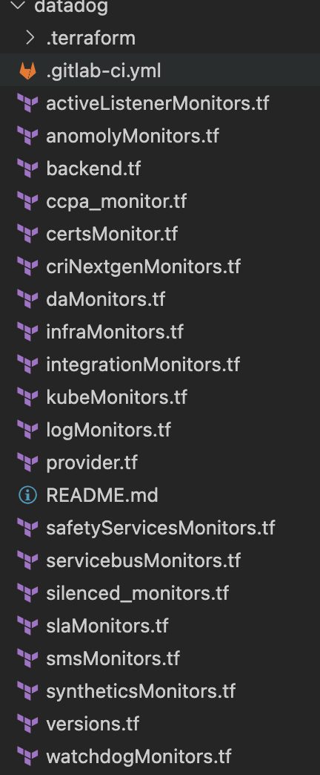
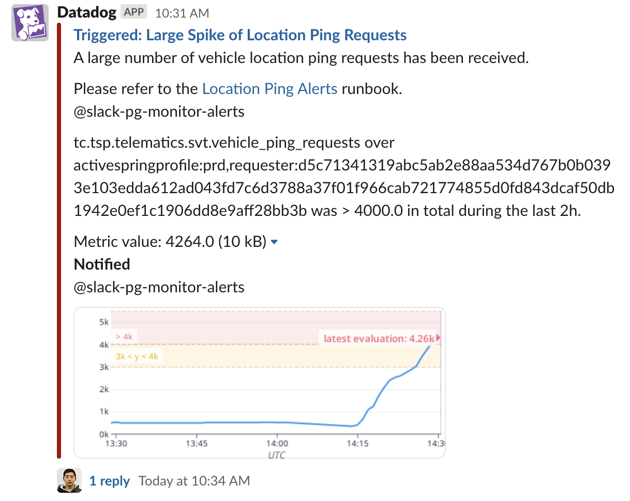
Monitors
~300 Datadog Monitors
Slack & Pagerduty

Slide 14
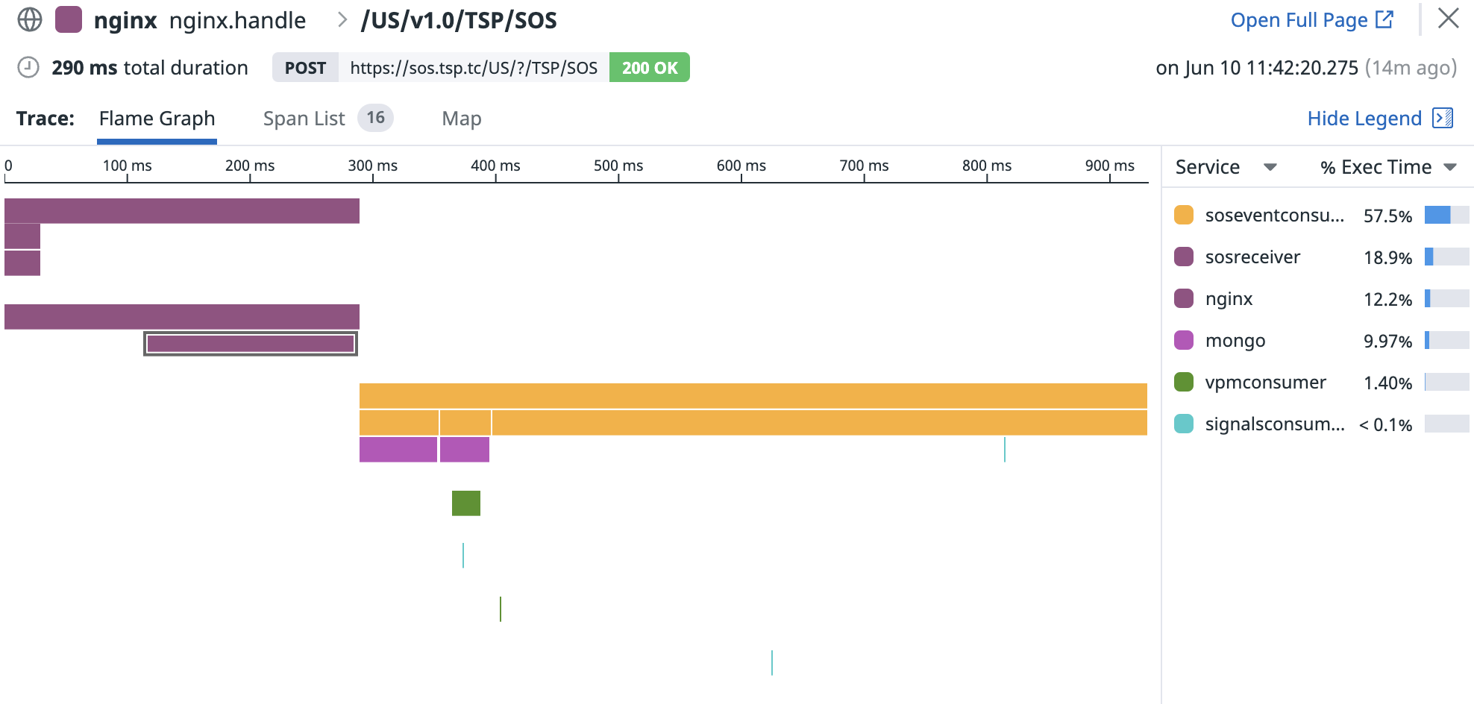
Tracing

Slide 15
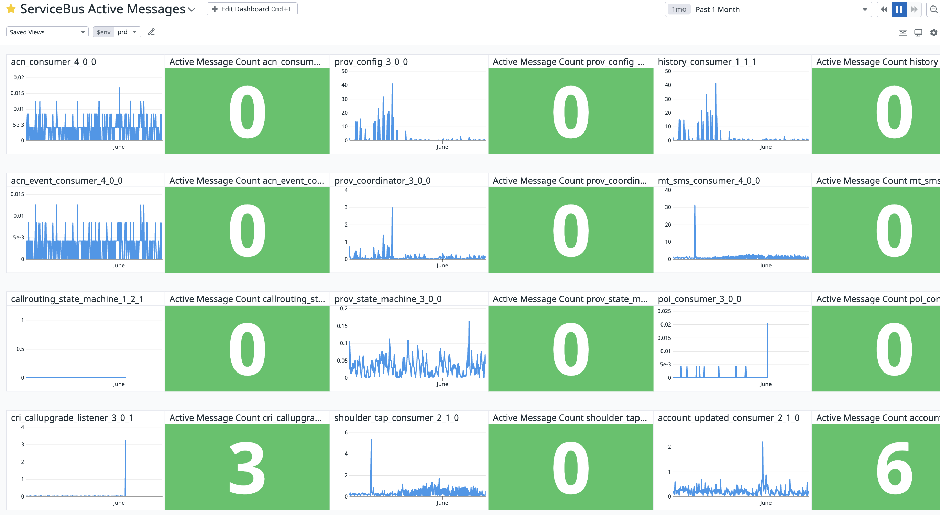
Dashboards

Slide 16
STEP 3:
SECURITY

Slide 17

Security
Public Network
Private Network
Twistlock
DDOS protection

Slide 18
STEP 4:
TESTING

Slide 19
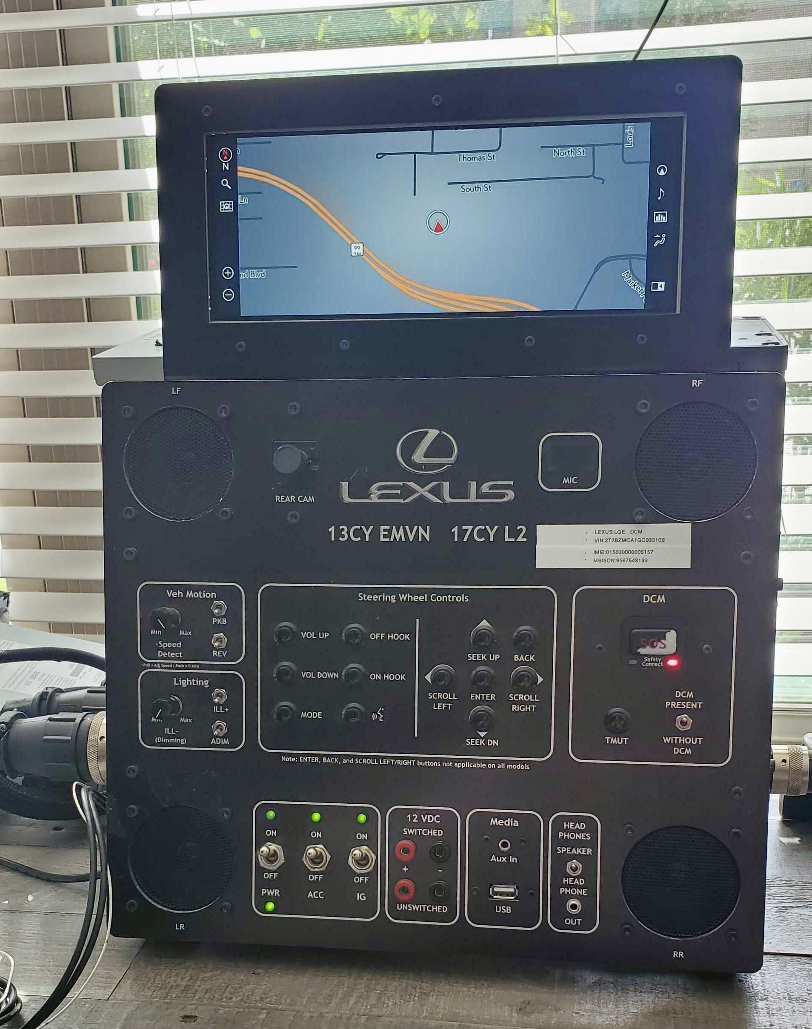
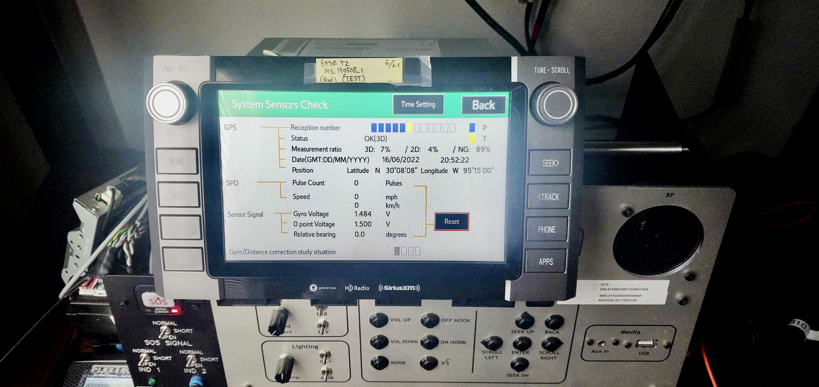
Test Benches

Slide 20

Ikura – The TSP Testing Tool

Slide 21
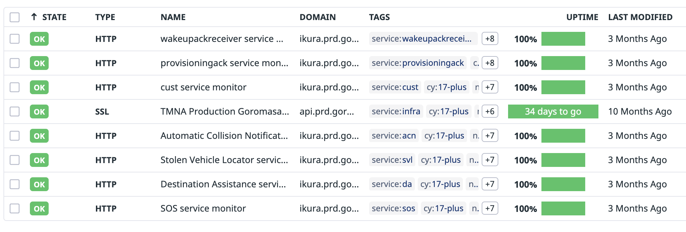
Synthetics

Slide 22
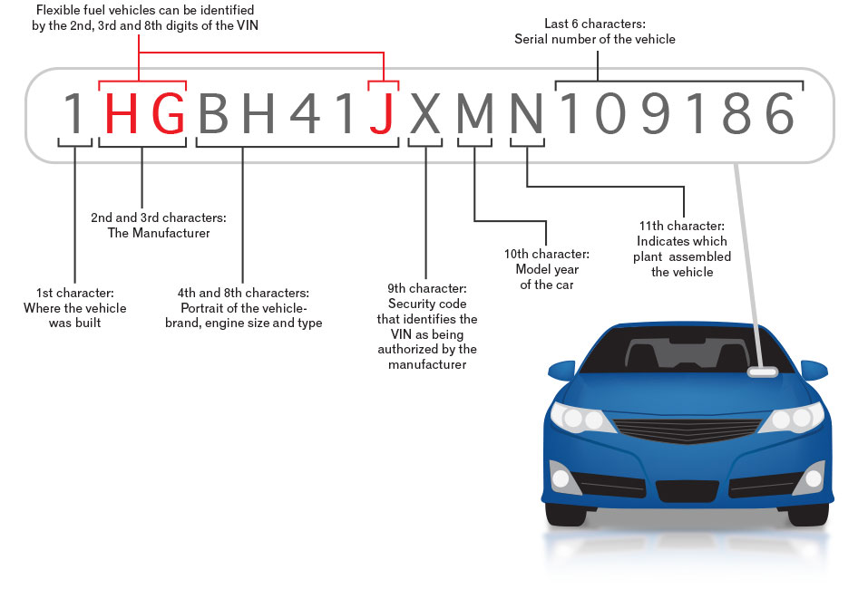

Slide 23
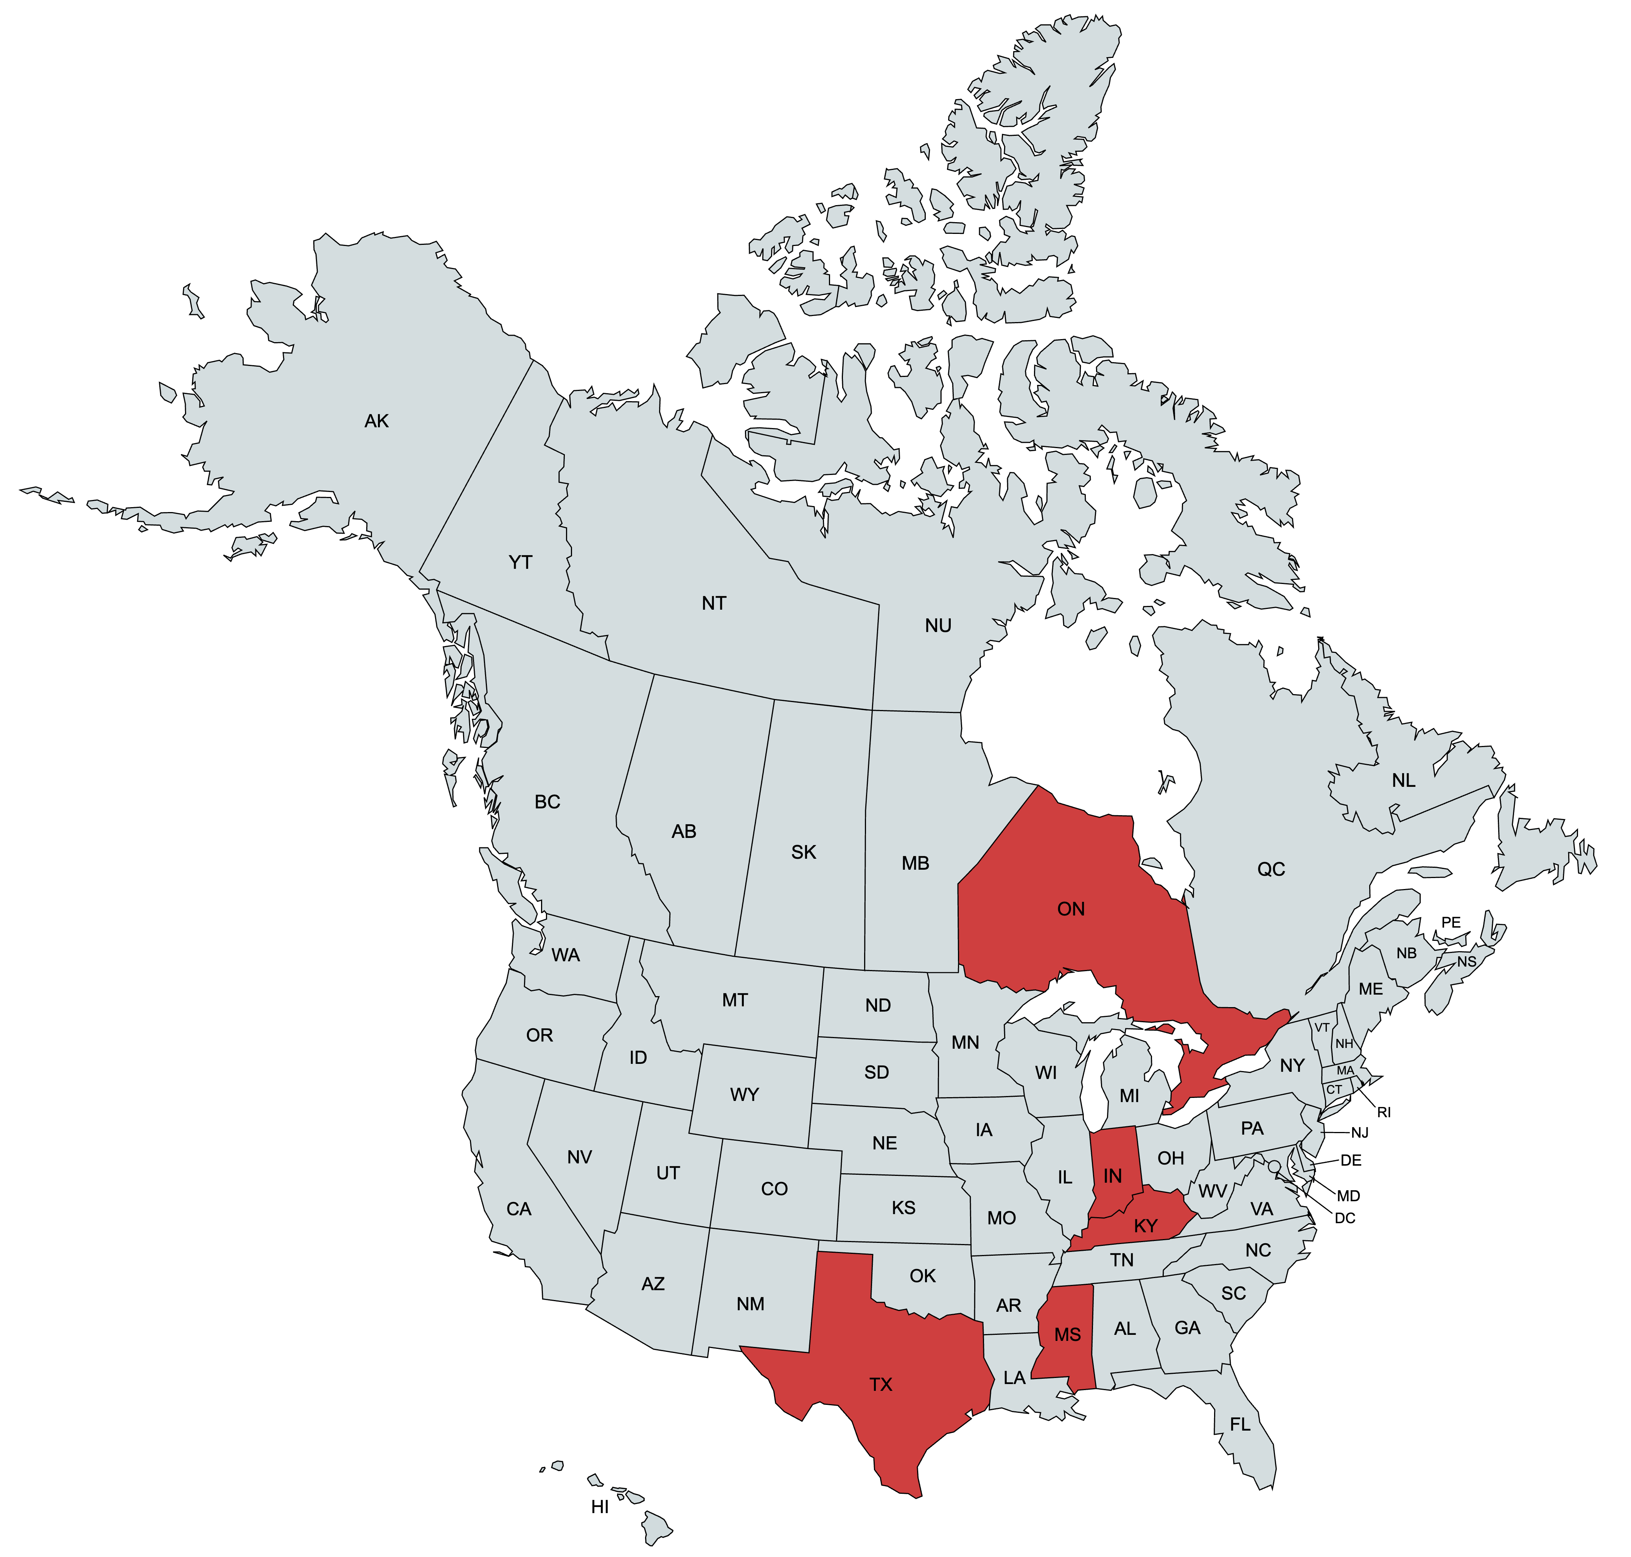

Slide 24
STEP 5:
ISSUE PREPAREDNESS

Slide 25
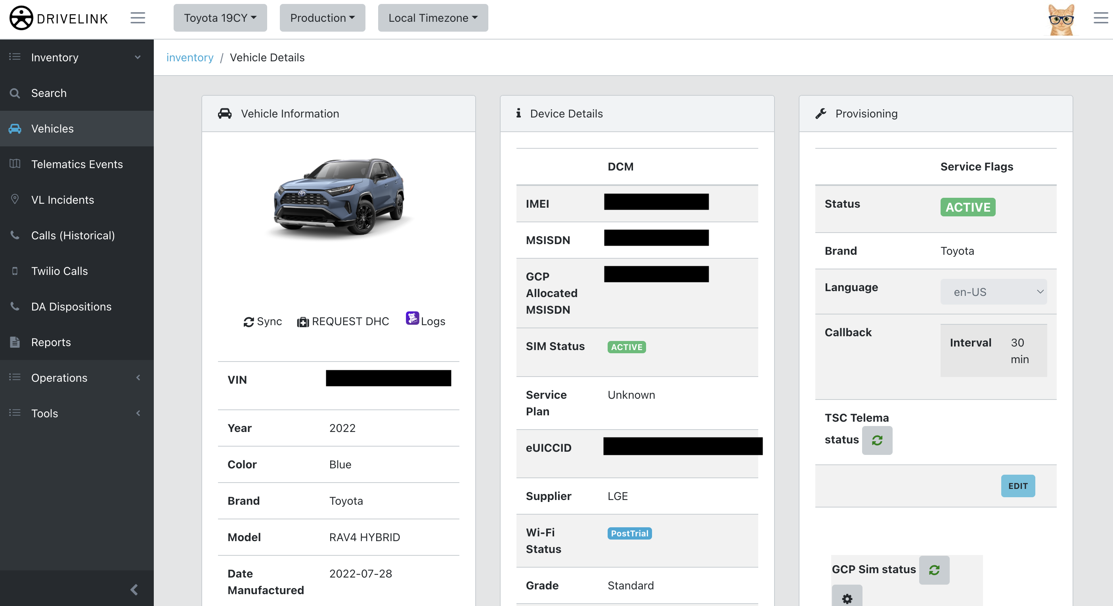
Operations UI

Slide 26

On Call & Runbooks
Pagerduty
24/7 Tier 1 support in NA & India
Escalation plans
Runbook links on Monitors
Command Center

Slide 27

STEP 6:
LAUNCH

Slide 28
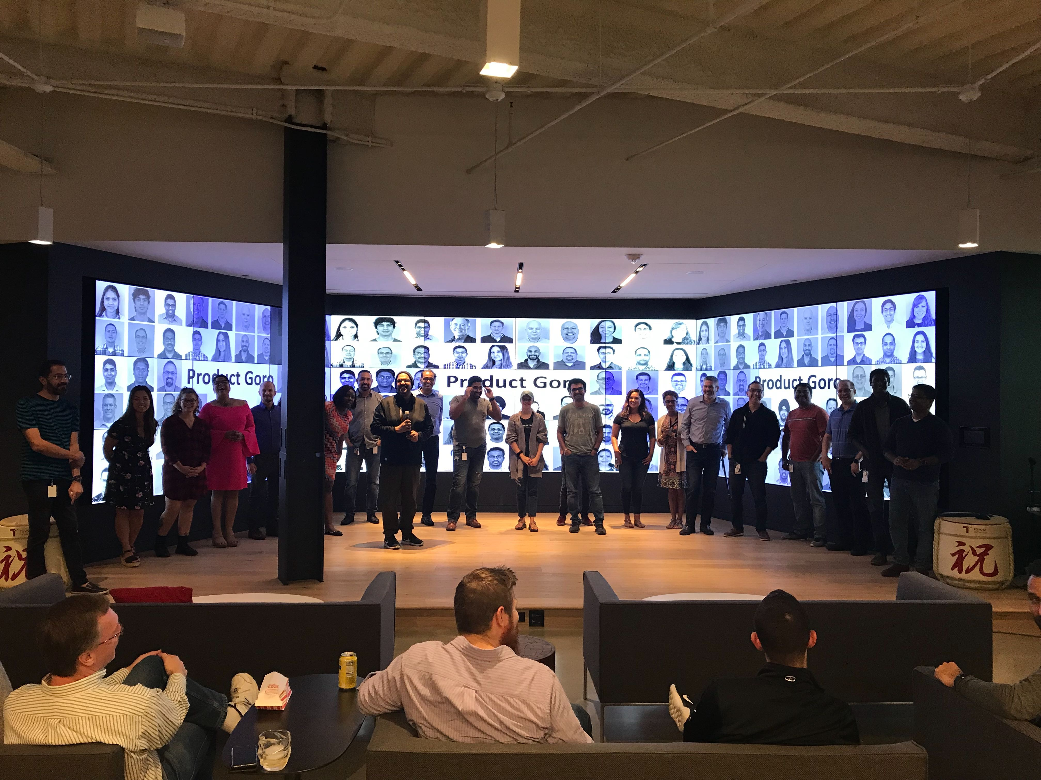
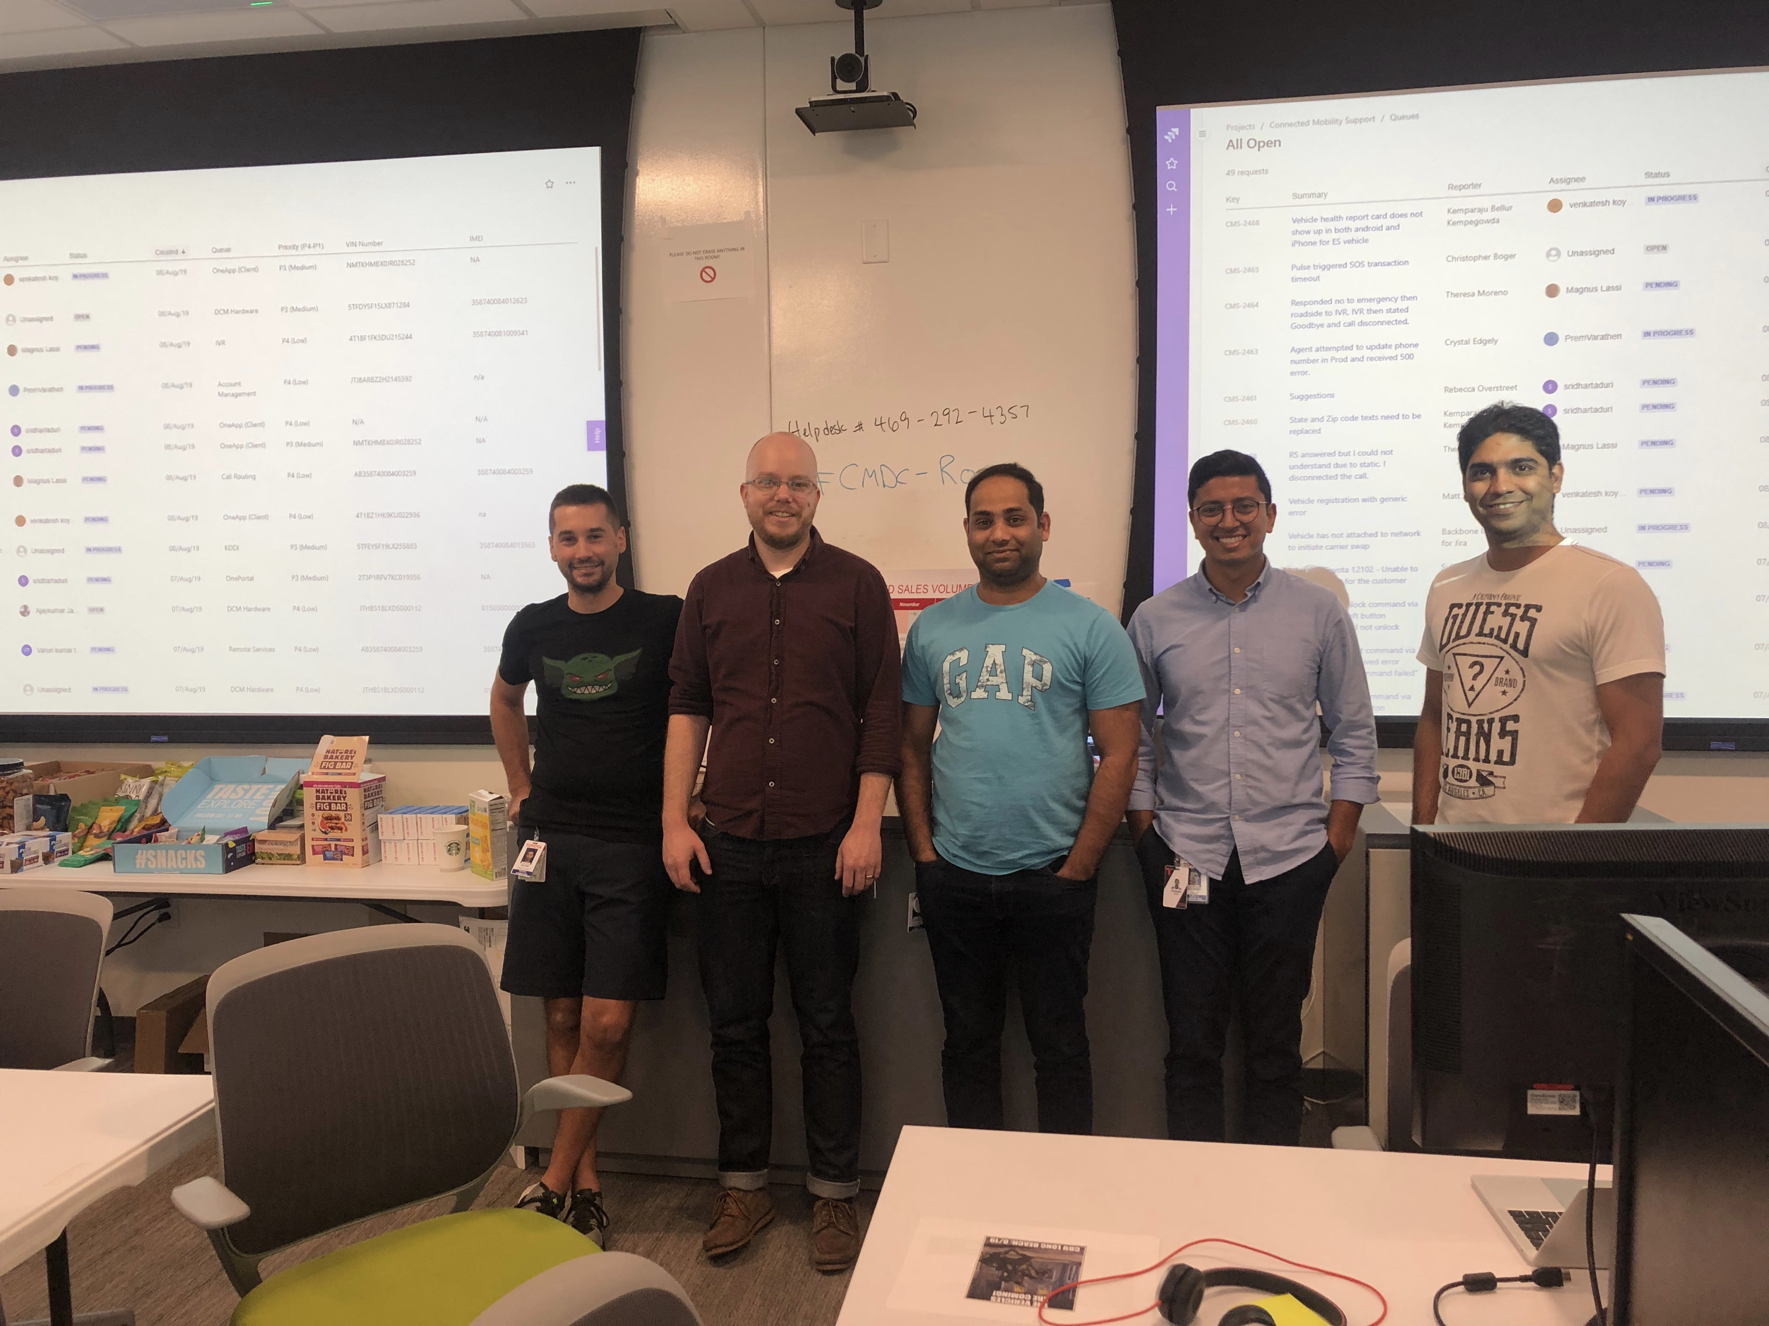
Launch Day!
August 5, 2019

Slide 29
STEP 7:
KAIZEN

Slide 30





Platform Enhancements
Cron jobs to scale up/down “activation” services in preparation for large batches 2x day
UX improvements in Salesforce for call center agents
Platform migrations ( , , )
Right-sizing pods for java applications to prevent restarts
Onboarding other Toyota entities and manufacturers
Etc…

Slide 31
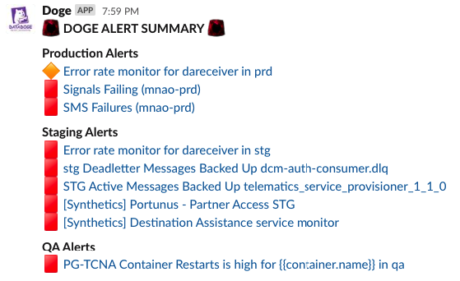

DevOps Improvements
More monitors! (~800)
Connect HPAs to custom metrics
Transition to Datadog Logging
Watchdog
“doge standup” slackbot

Slide 32

Stack (Now)
Code
Infrastructure
Java (Spring Boot)
Go
Maven
RabbitMQ (Messaging)
Mongo (Database)
Redis (Cache)
GitLab
AWS
EKS (Kubernetes)
Nginx
Datadog (logging)
Datadog (monitoring)

Slide 33
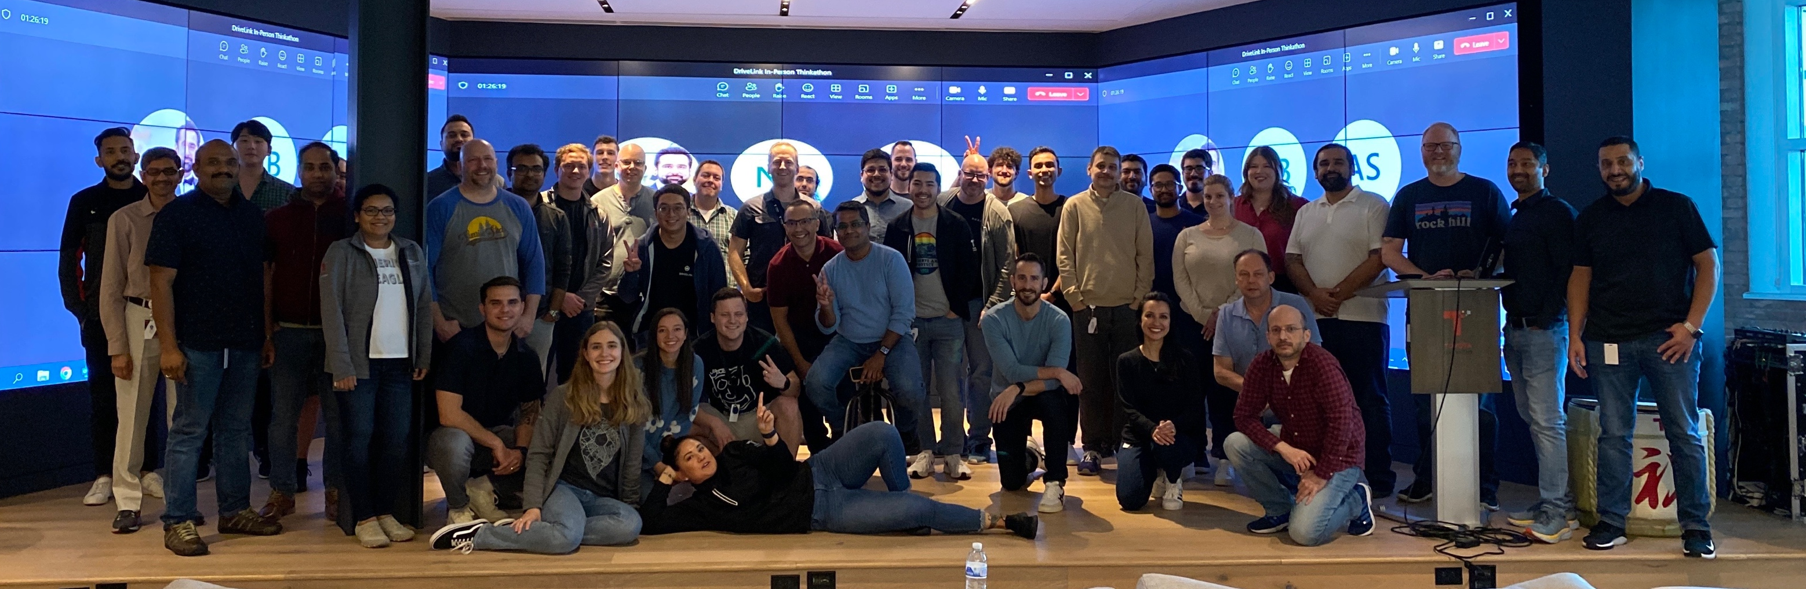
What Do We Look Like Now?
>6 Million Vehicles
~3k Calls/Day
51% = Destination Assist
36% = Subscription
8% = SOS
5% = Collision

Slide 34
Thank you!
We’re hiring! https://toyotaconnected.com/careers

